Slide 1
An investigation into the usefulness of the Smart Watch Interface for university students
Investigator:
Kyle Johnson
Project Supervisors:
Prof. Hannah Thinyane
Mrs. Ingrid Siebörger

Slide 2
This seminar will cover
What the goals were
Work done
Findings
Future Work

Slide 3
The Project: Goals
Different target audiences would want a smart watch for different things.
Investigation into whether the smart watch can be a potentially useful device to university students (student-device interaction)
The type of information (applications) which would be considered the most useful by students on a smart watch.

Slide 4
The Project: Questions
So why would students want to use a smart watch?
Would the usability of applications on the smart watch be easier than on a smart phone? (Perhaps in particular circumstances?)
Questions were answered via proof of concept applications requested by CS1L (quantitative research).

Slide 5
Methodology
The Spiral model (Boehm, 1988) was used to implement the applications found to be of most value to students.
Iterative framework (Each iteration passes through 4 phases)
This research uses two iterations of this framework

Slide 6
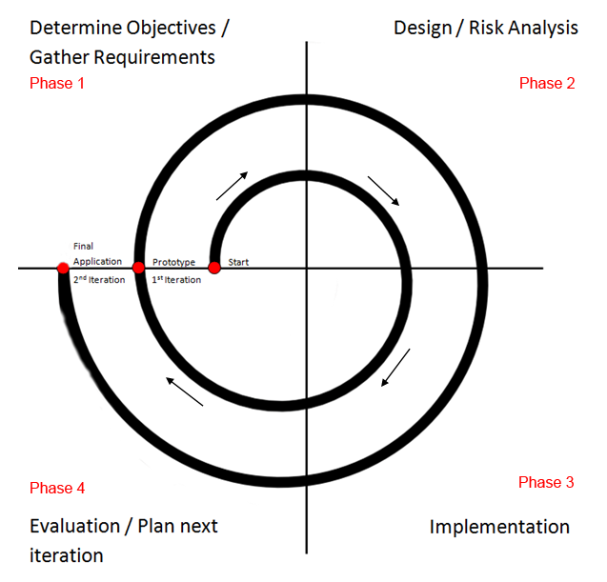
Spiral Model

Slide 7
Prototype Development 1st Iteration
Requirements gathering (questionnaire) (phase 1)
Mock-ups (phase 2)
Prototype (phase 3)
Evaluation (Expert Users) (phase 4)

Slide 8
Requirements Gathering
This questionnaire used a broad scope of participants to gain data (low fidelity / large breadth on multiple features & tasks).
User questionnaire with CS1L class (n=211)
89 participants (quantitative)
Available on Google Forms in afternoon pracs

Slide 9
Questionnaire findings
Majority of respondents were interested in using a
smart watch for information retrieval
Convenience of an always accessible on-wrist interface
Physical security of having device attached to arm
Similar features to smart phone with added portability
Curiosity for new tech

Slide 10
More findings
Possible perceived deterrents found when using a smart watch as per the questionnaire:
Both devices can access the same information (Why use a watch when you can use a phone?)
Adaptation to a new interface can be intimidating to users. They need to be motivated to learn how to use a smart watch over already established interfaces.
Small screen and limited buttons for human-device interaction

Slide 11
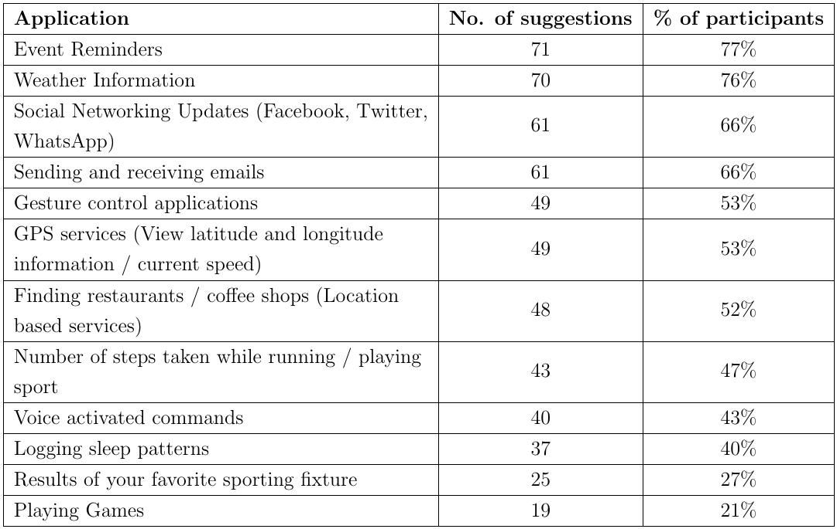
Requested Apps
Applications which participants requested:

Slide 12
Requested Apps
Weather, Calendar, Email functionality
Participants were asked what applications they would like to see on a smart watch besides those suggested.
The most popular one was found to be a phone finder
Design (mock-ups) and Implementation (prototypes) of these applications proceeded

Slide 13
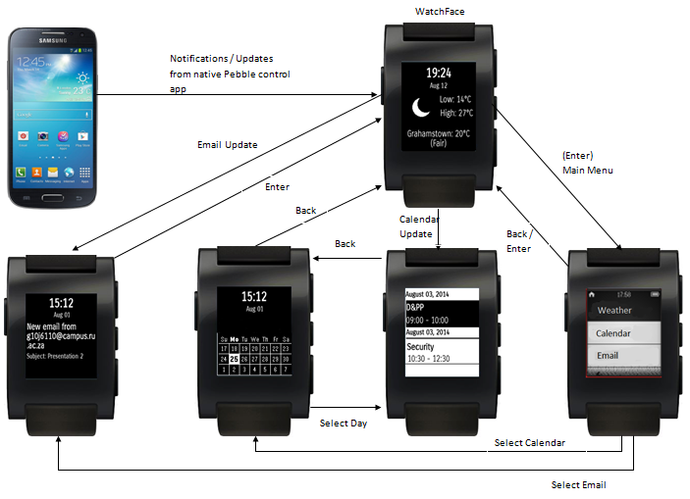
Mock-up: Notifier App

Slide 14
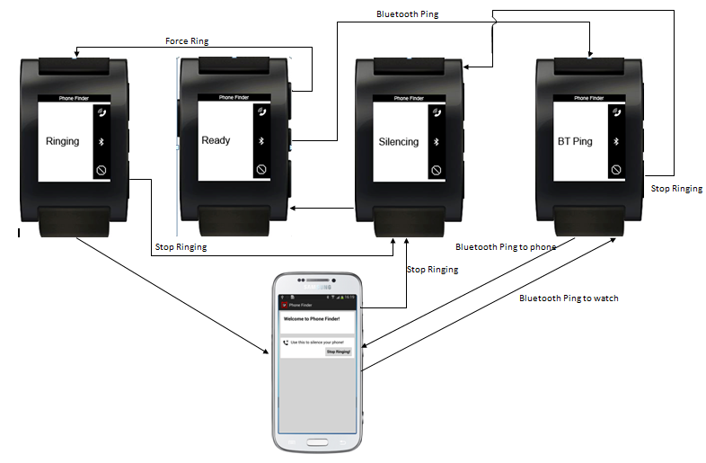
Mock-up: Phone Finder App

Slide 15
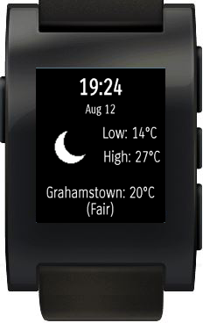
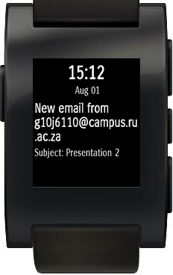
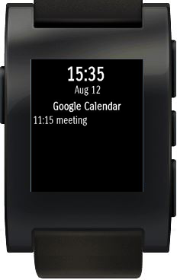
Prototype Development: Notifier Application
1. Weather
2. Email
3. Calendar

Slide 16
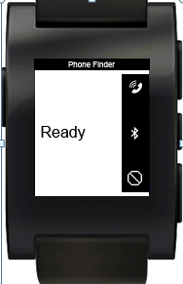
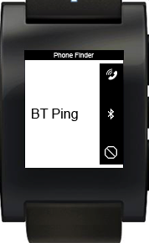
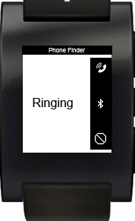
Prototype Development: Phone Finder Application

Slide 17
Prototypes
Developed to demonstrate the use of notifications sent from the phone -> Pebble and as a proof of concept.
Control app will send notification messages to the Pebble in response to any relevant information received on the phone.
Highlights the mechanism used to push information to and from phone and watch.

Slide 18
Expert User Evaluation
Two expert users were asked to evaluate the prototypes.
For the notifier app: found that it would be better to make the weather watch face the main screen, include larger fonts / icons, and include a vibration notification before the time of a calendar appointment.
Phase 4 in the spiral model, first iteration. Findings here used for the requirements gathering of second iteration (Actual development of both applications).

Slide 19
Application Development 2nd Iteration
Requirements gathering (Expert User Feedback) (phase 1)
UML Diagrams (phase 2)
C / Android (Java) Development (phase 3)
Field Study (phase 4)

Slide 20
Development: Notifier Application
Integration of the Weather, Calendar and Email functionalities into one application.
Developed in C on the CloudPebble IDE.
Displayed the message passing concept between watch and phone using dictionary structures (key-value pairs)
Keys -> Functionality selection / what to update

Slide 21
Development: Phone Finder Application
Review of existing phone finder apps revealed the following:
No bypass of Android phone state (mute to loud) in order to force sound output (no multi-modality support).
Most are not free
Have limited methods to find a phone (Ringing / vibration most popular)
Have unnecessarily complicated companion apps installed on Android phone

Slide 22
Development: Phone Finder Application
The new implementation takes these into consideration.
Allows for activation of RingingService on an Android phone
Uses Bluetooth signal strength to determine phone proximity to watch, succession of watch vibrations increase in frequency the stronger the signal gets.
Minimal companion app installed on phone (allows for the change of phone states and access to multi-media libraries).
C (watch app) / Java (companion) using Android dev tools + PebbleKit SDK

Slide 23
Usability Testing
Evaluation conducted as a Field Study, allowed for testing in a more natural environment for participants than a lab setting.
6 participants from CS202 for Qualitative research.
Demographics:

Slide 24
Usability Testing
Done to gain a deeper understanding of how users interacted with the smart watch and the installed applications (High fidelity).
Participants used the watch for a day, and were evaluated in the afternoon.
Used an online questionnaire and an interview to evaluate the user experience with the watch.
Participants ranked each question in questionnaire on a scale from 1 – 5; where 1 = strongly disagree, 2 = disagree, 3 = neutral, 4 = agree, 5 = strongly agree

Slide 25
Findings

Slide 26
Findings

Slide 27
Findings

Slide 28
Interview Findings
The smart watch as a useful interface:
5/6 participants found some benefit in using the applications on the watch.
Found to be useful in situations where small amounts of information could be viewed at a time.
Participants found that using the watch to retrieve information was convenient in a real-world environment.
3 / 6 participants found a use for the smart watch in a lecture environment, convenient to be connected to received notifications on their phones.

Slide 29
Interview Findings
While most participants acknowledged the usefulness of the watch, female participants were less willing to use the smart watch to view information on. Was “awkward” and “uncomfortable” to use.
Male participants wanted to use the watch more on a daily basis. Mentioned it had a “Novelty” value to it.
Same novelty factor was found when using the phone finder application among all participants:
All participants were found to want to use it if they had lost their phone.
Curiosity for wanting to use a new way to find a phone.

Slide 30
Future Work
Based on the results obtained through the Field study, another iteration in the Spiral model could be performed where the notifier and phone finder applications are improved upon:
More intuitive way of turning off the Bluetooth connection between the phone from the watch.
Highlighting days of the week on which there are appointments in the calendar functionality of the notifier app.
Study how participants can benefit from the smart watch in a lecture environment.

Slide 31
